Slide 1
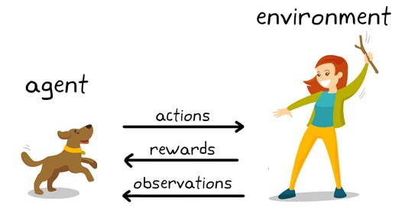
Fundamentals of Reinforcement Learning:- Markov Decision Processes and Dynamic Programming
Siddharth Dey
ME18B075

Slide 2
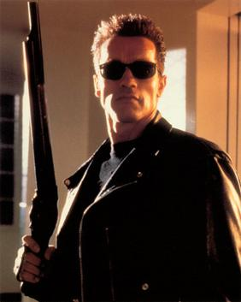
- Most of todays Artificial intelligence revolves around supervised learning which requires large amount of annotated data for good accuracies. But when do we picture when we say AI
Yes, a killer machine searching for people and hunting them down
Have we achieved this level of intelligence?
Ans) Somewhat
Solution?
Reinforcement Learning

Slide 3
- Let us try to understand the literature’s terminology by considering an autonomous path planning algorithm for a drone flying around in an unknown environment
The learner and decision maker is called the agent. In our case, it is the drone
The things it interacts with, comprising of everything outside the agent is the environment. In our case, it will be the nearby trees and buildings
Let the current state be S_t (say the (x1,y1,z1) location of drone). In this state it can take a certain set of actions(say left, right, up, down, forward, back)
Based on the action it takes, it gets a reward R_t+1 by interacting with the environment (say negative penalty for obstacle collision and positive reward for reaching goal

Slide 4
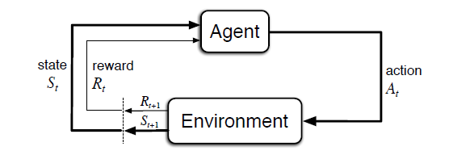

This is how an agent interaction with the environment graphically looks like.
So the environment and agent interaction gives rise to a sequence or trajectory like this:
S0,A0,R1,S1,A1,R2,S2,A2,R3 ……..
If the new state depends only on the previous state, we call it a Markov Decision Process
- The function ‘p’ defines the dynamics of the MDP. In many cases, the movement is deterministic and this can be ignored in calculations

Slide 5
- Any problem of learning goal-directed behavior can be reduced to three signals passing back and forth between an agent and its environment: one signal to represent the choices made by the agent (the actions), one signal to represent the basis on which the choices are made (the states), and one signal to define the agent’s goal (the rewards). This framework may not be sufficient to represent all decision-learning problems usefully, but it has proved to be widely useful and applicable.
The rewards can be thought of as a way for the user way to tell the agent about the goodness of its actions
- The agent’s goal can be thought to maximize the total amount of reward it receives, more formal definition:
Maximization of the expected value of the cumulative sum of a received
scalar signal (called reward)
Hence comes the definition of ‘Return’ and we seek to maximize the expected return which is the sum of rewards of all future time steps.
G_t = R_t+1 + R_t+2+……+R_T; where T is the final time step

Slide 6

Mostly, we use discounting and we choose A_t to maximixe the expected discount return:-
Where γ is called the discount rate between 0 and 1. Discount rate determines how far-sighted the agent is, as it approaches 0, it considers only immediate returns and vice versa . We can also derive a recurrence relation for the expected return. It can be easily seen that:
G(t) = R(t+1) + γ*G(t+1)

Slide 7


Policies and Value Functions
- a policy is a mapping from states to probabilities of selecting each possible
action. If the agent is following policy π at time t, then π(a|s) is the probability that
At = a if St = s.
- The value function of a state s under a policy π, denoted v_π(s), is the expected return when starting in s and following π thereafter
(The state value function of the terminal states is always zero).
- Similarly, we can define the action value function as the expected return starting from s, taking the action a, and thereafter following policy π :

Slide 8



After some rearrangement, it can be shown that:-
v_π =
- The above equation is called the Bellman equation. This equation forms the basis for value evaluation which we will discuss later.
OPTIMAL POLICIES AND OPTIMAL VALUE FUNCTONS
A policy is said to be optimal if the state value functions for each state following that policy is greater than other policy, i.e ,
, for all states ‘s’( The ‘*’ denotes the optimal policy values)
The same can be said for action-value functions.
It can be mathematically proved that there always exists an optimal policy

Slide 9


The Bellman Optimality equation
This equation forms the basis of Reinforcement Learning.
The state value and action value functions under optimal policy can be given as :-
V*(s) =
And action-value functions as:
Q*(s,a) =
- These Bellman Optimality forms the basis for all the other Advanced Reinforcement algorithm.

Slide 10
Dynamic Programming
POLICY EVALUATION:
For any policy π, we know the definition of state value function :
V(s) = ∑π(a/s)*[ r + γV(s’) ]
We can assume random values for each state initially and use this definition as an update rule by looping through each state until the values converge
POLICY IMPROVEMENT:
Let us say we have a 2d Grid and we want to reach the terminal states(say the top-left corner and bottom-right corner).Initially we assume a random policy(i.e, all action (up, down, left, right) are equally likely) and compute the state values using this policy. But in order to improve a policy, we can assume a greedy policy w.r.t the current state value functions which looks best in the short-term, i.e,
Π’(s) = argmax(a)[ r + γ*v_π(s’)]
Value evaluation under this greedy policy becomes the Bellman optimality equation

Slide 11
There are two methods of Value Evaluation followed by Policy Improvement :
POLICY ITERATION – We perform policy evaluation until convergence followed by policy improvement (using the greedy policy) until the policy becomes stable.
2) VALUE ITERATION – Almost the same as above but policy evaluation is stopped after one sweep ( one update of each state ). It can be written as an update rule which combines both policy improvement and truncated policy evaluation steps
v_k+1 = max(a)[ r + γ*v_k(s’) ]
Which is the same as using Bellman Optimality equation as an update rule

Slide 12
VALUE ITERATION (algorithm):-
Algorithm parameter: a small threshold θ > 0 determining accuracy of estimation
Initialize V (s), for all s Є S+, arbitrarily except that V (terminal) = 0
Loop for each s Є S :
delta = 0
v = V(s)
V(s) = max(a)[ r + γ*V(s’) ]
delta = max(delta, |v – V(s)|)
Until delta < θ
Output a deterministic policy , π = π* such that
π(s) = argmax(a)[ r + γ*V(s’)]
The same has been coded in C++ for demonstration

Slide 13
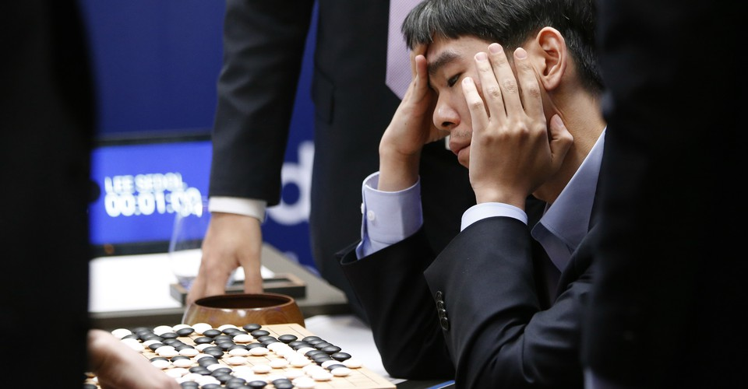
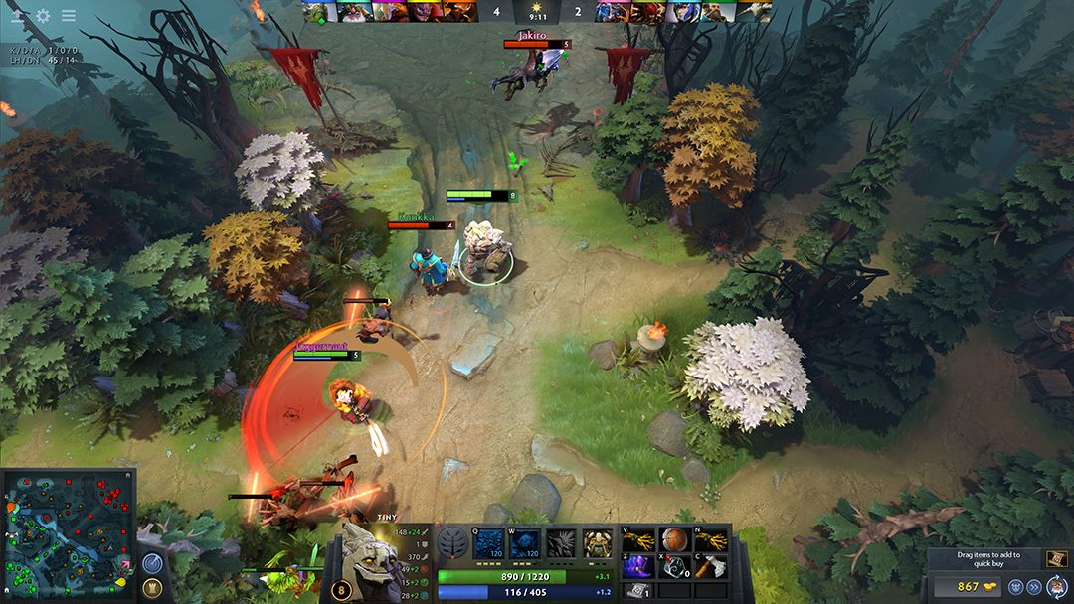
Current achievements of RL:
Google’s DeepMind AlphaGo , a computer Go program defeated Fan hui ( European Champion) in a Five Game Go match (a board game like chess)
2) OpenAI Five, an AI agent, defeated human world champions in a best-of-three contest at Dota 2, a popular and complex online strategy game
3) Is it only limited to games?
I am working on a project where me and my teammates are trying to use Deep Reinforcement Algorithms like DQN and Actor-Critic for autonomous Drone navigation using only depth camera for input

Slide 14
References:-
Reinforcement Learning: An Introduction (Richard S. Sutton and Andrew G. Barto)
https://medium.com/ai%C2%B3-theory-practice-business/reinforcement-learning-part-1-a-brief-introduction-a53a849771cf
https://www.youtube.com/watch?v=nyjbcRQ-uQ8&list=PLZbbT5o_s2xoWNVdDudn51XM8lOuZ_Njv

Slide 15
THANK YOU

